Slide 1
CES 361
Fundamentals of Software Testing
Session 18
Automated Testing

Slide 2
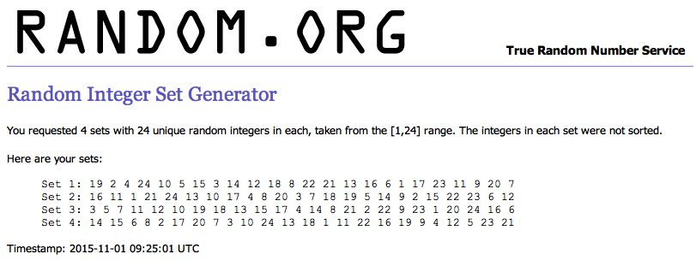
In-Class Exercise
Log onto Pilot
Upload your test file (LASTNAME.txt)
upload to Communications>Discussions
Download the six test files you will run
if an assigned file is missing, pick another file that you are not assigned

Slide 3
TESTER | RUN 1 | RUN 2 | RUN 3 | RUN 4 | RUN 5 | RUN 6
Bevins, Sam | Bollinger | Shanahan | Borkowski | Donovan | Kloos | Reisner
Bollinger, Scott | Borkowski | Joyce | Simmons | Cripps | Clay | Reisner
Borkowski, Jeffrey | Carr | Gross | Joyce | Walker | Haller | Reisner
Carr, Sebastian | Clay | Borkowski | Haller | Nichols | Walker | Reisner
Clay, Jordan | Cripps | Haller | Nguyen | Bevins | Wintermute | Reisner
Cripps, Jonathan | Donovan | Nichols | Wolfe | Kelley | Borkowski | Reisner
Donavan, Patrick | Gross | Worley | Kelley | Bollinger | Gross | Reisner
Gross, Matthew | Haller | Bollinger | Haver | Worley | Carr | Reisner
Haller, Colton | Haver | Wintermute | Shanahan | Borkowski | Simmons | Reisner
Haver, Zachary | Hudson | Clay | Donovan | Konate | Haver | Reisner
Hudson, Cynthia | Joyce | Wells | Bollinger | Simmons | Konate | Reisner
Joyce, Jonathan | Kelley | Haver | Worley | Carr | Wells | Reisner
Kelley, Craig | Kloos | Konate | Cripps | Clay | Joyce | Reisner
Kloos, Devin | Konate | Cripps | Nichols | Haver | Bevins | Reisner
Konate, Bala | Nguyen | Donovan | Walker | Kloos | Bollinger | Reisner
Nguyen, Khoa | Nichols | Bevins | Bevins | Hudson | Nichols | Reisner
Nichols, Ryan | Shanahan | Simmons | Gross | Joyce | Kelley | Reisner
Shanahan, Devin | Simmons | Hudson | Kloos | Haller | Shanahan | Reisner
Simmons, Lori | Walker | Nguyen | Konate | Gross | Worley | Reisner
Walker, James | Wells | Wolfe | Hudson | Wintermute | Nguyen | Reisner
Wells, Zachary | Wintermute | Kloos | Carr | Nguyen | Wolfe | Reisner
Wintermute, Kyle | Wolfe | Kelley | Wells | Shanahan | Hudson | Reisner
Wolfe, Amanda | Worley | Walker | Wintermute | Wells | Cripps | Reisner
Worley, Brett | Bevins | Carr | Clay | Wolfe | Donovan | Reisner

Slide 4
In-Class Exercise
Log onto Pilot
Upload your test file (LASTNAME.txt)
upload to Communications > Discussions
Download the test files you will run
if an assigned file is missing, pick another file that you are not assigned
Yell “Buggo!” if an error is found
Class discussion

Slide 5
Intentionally Blank Slide

